Slide 1
Data Visualizations: Empowering Business with Effective Insights

Slide 2
Introduction
In this Presentation, we will understand our Company’s sales performance for the years 2010 and 2011
I appreciate the opportunity given to me to gain insightful information about the store’s performance. I hope you find the analysis compelling and helpful as you make decisions regarding future business opportunities.
I want to assure you that I’ve provided the most up to date and error free analysis

Slide 3
Findings

Slide 4
Revenue by Month, 2011
The first 8 months had stable monthly revenue with an average of $685,000.
We had a significant increase in revenue from September with revenue at $1.51 Million and an average of 21.18% increase in revenue from August to November.
The revenue trend from August to December demonstrates how seasonality affects retail sales.

Slide 5
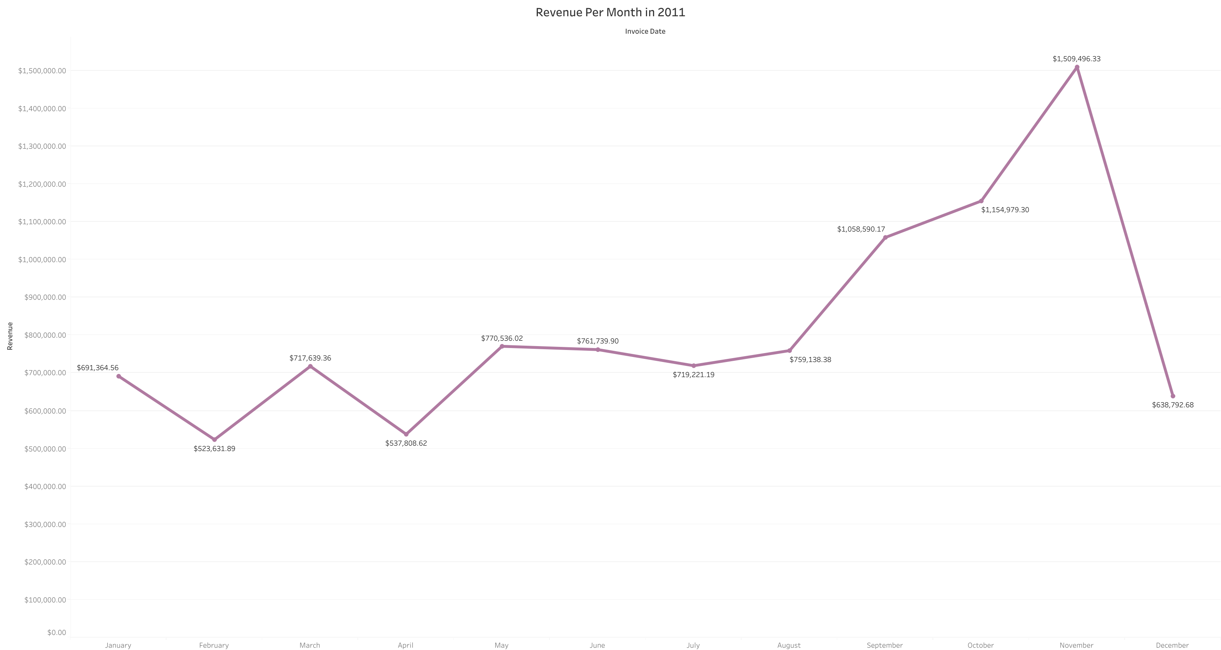

Slide 6

Top 10 Countries by Revenue and their Quantity

Slide 7
Top 10 Countries by Revenue and their Quantity
This chart represents the top 10 countries in revenue and their quantities bought in these countries except the UK.
There is no major difference between the revenue and the quantity of goods sold in these countries, showing a high purchasing power in these countries.
These countries represents regions with highest potential to generate more revenue that management needs to focus more on in terms of marketing strategies.

Slide 8
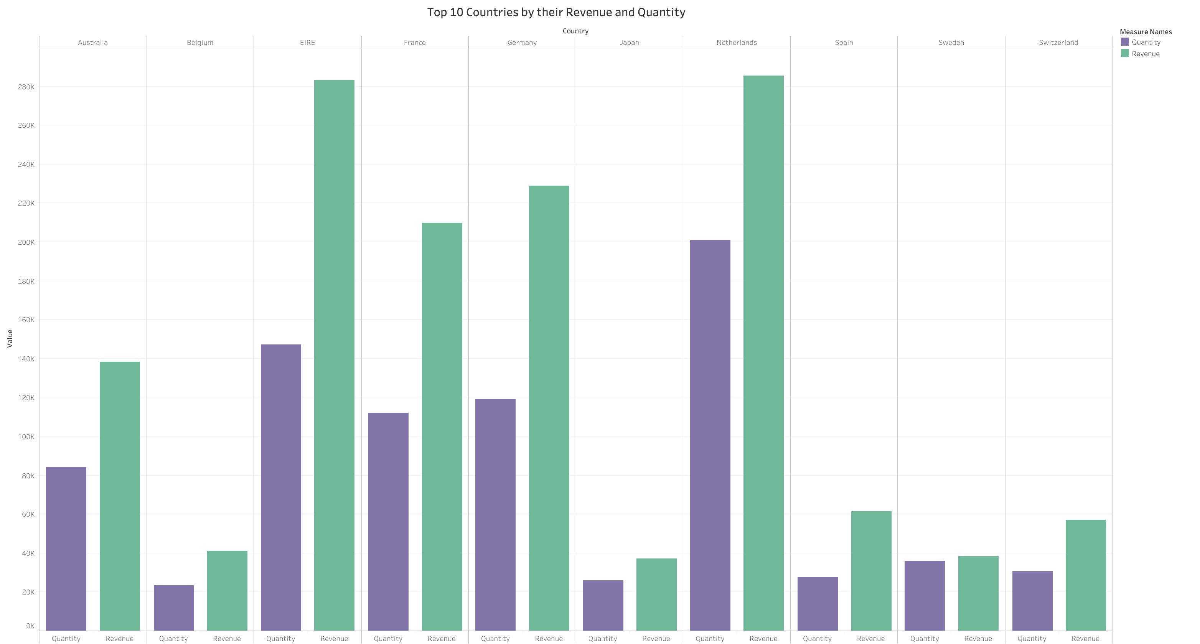

Slide 9
Top 10 Revenue Generating Customers

Slide 10
Top 10 Revenue Generating Customers
This chart represents the top 10 revenue generating Customers except from the UK.
The average difference in revenue between the top 10 customer is 15.8%.
The company can aim to strengthen the relationship with these customers to increase customer loyalty and retention, and ultimatelt drive more sales and revenue for the company.

Slide 11
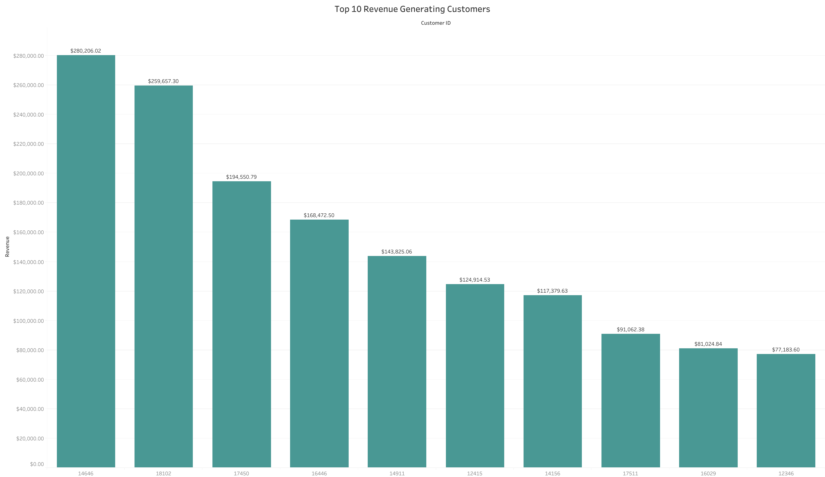

Slide 12
Revenue By Country

Slide 13
Revenue By Country
The map chart concludes by comparing the places that produced the greatest revenue to those that haven't.
The map also reveals that the majority of the sales occur only in European zone, with only a small number in American region.
Along with Russia, there is no market for the items in Africa and Asia
The company can aim to strengthen its market in European region and dive deeper in the region to come up with strategies that will maximize sales from each country region alongside Australia and Japan

Slide 14
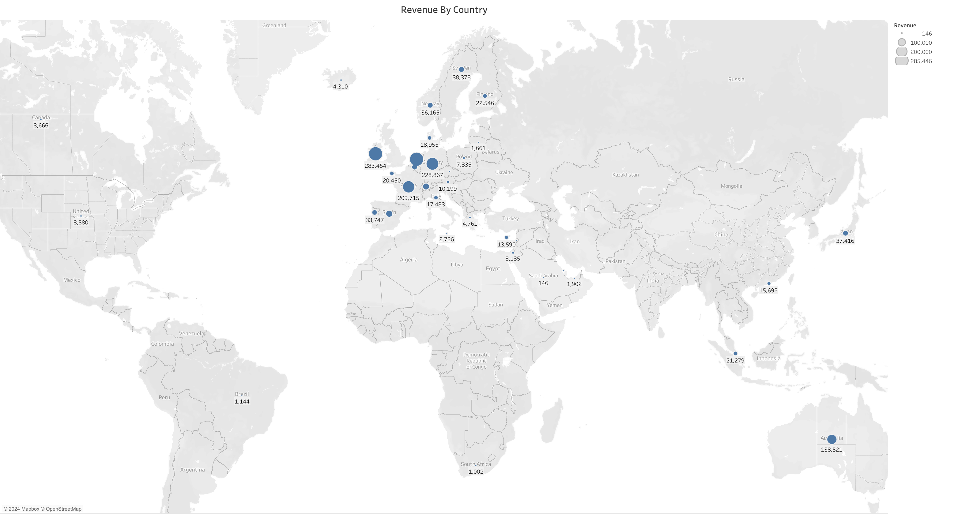

Slide 15
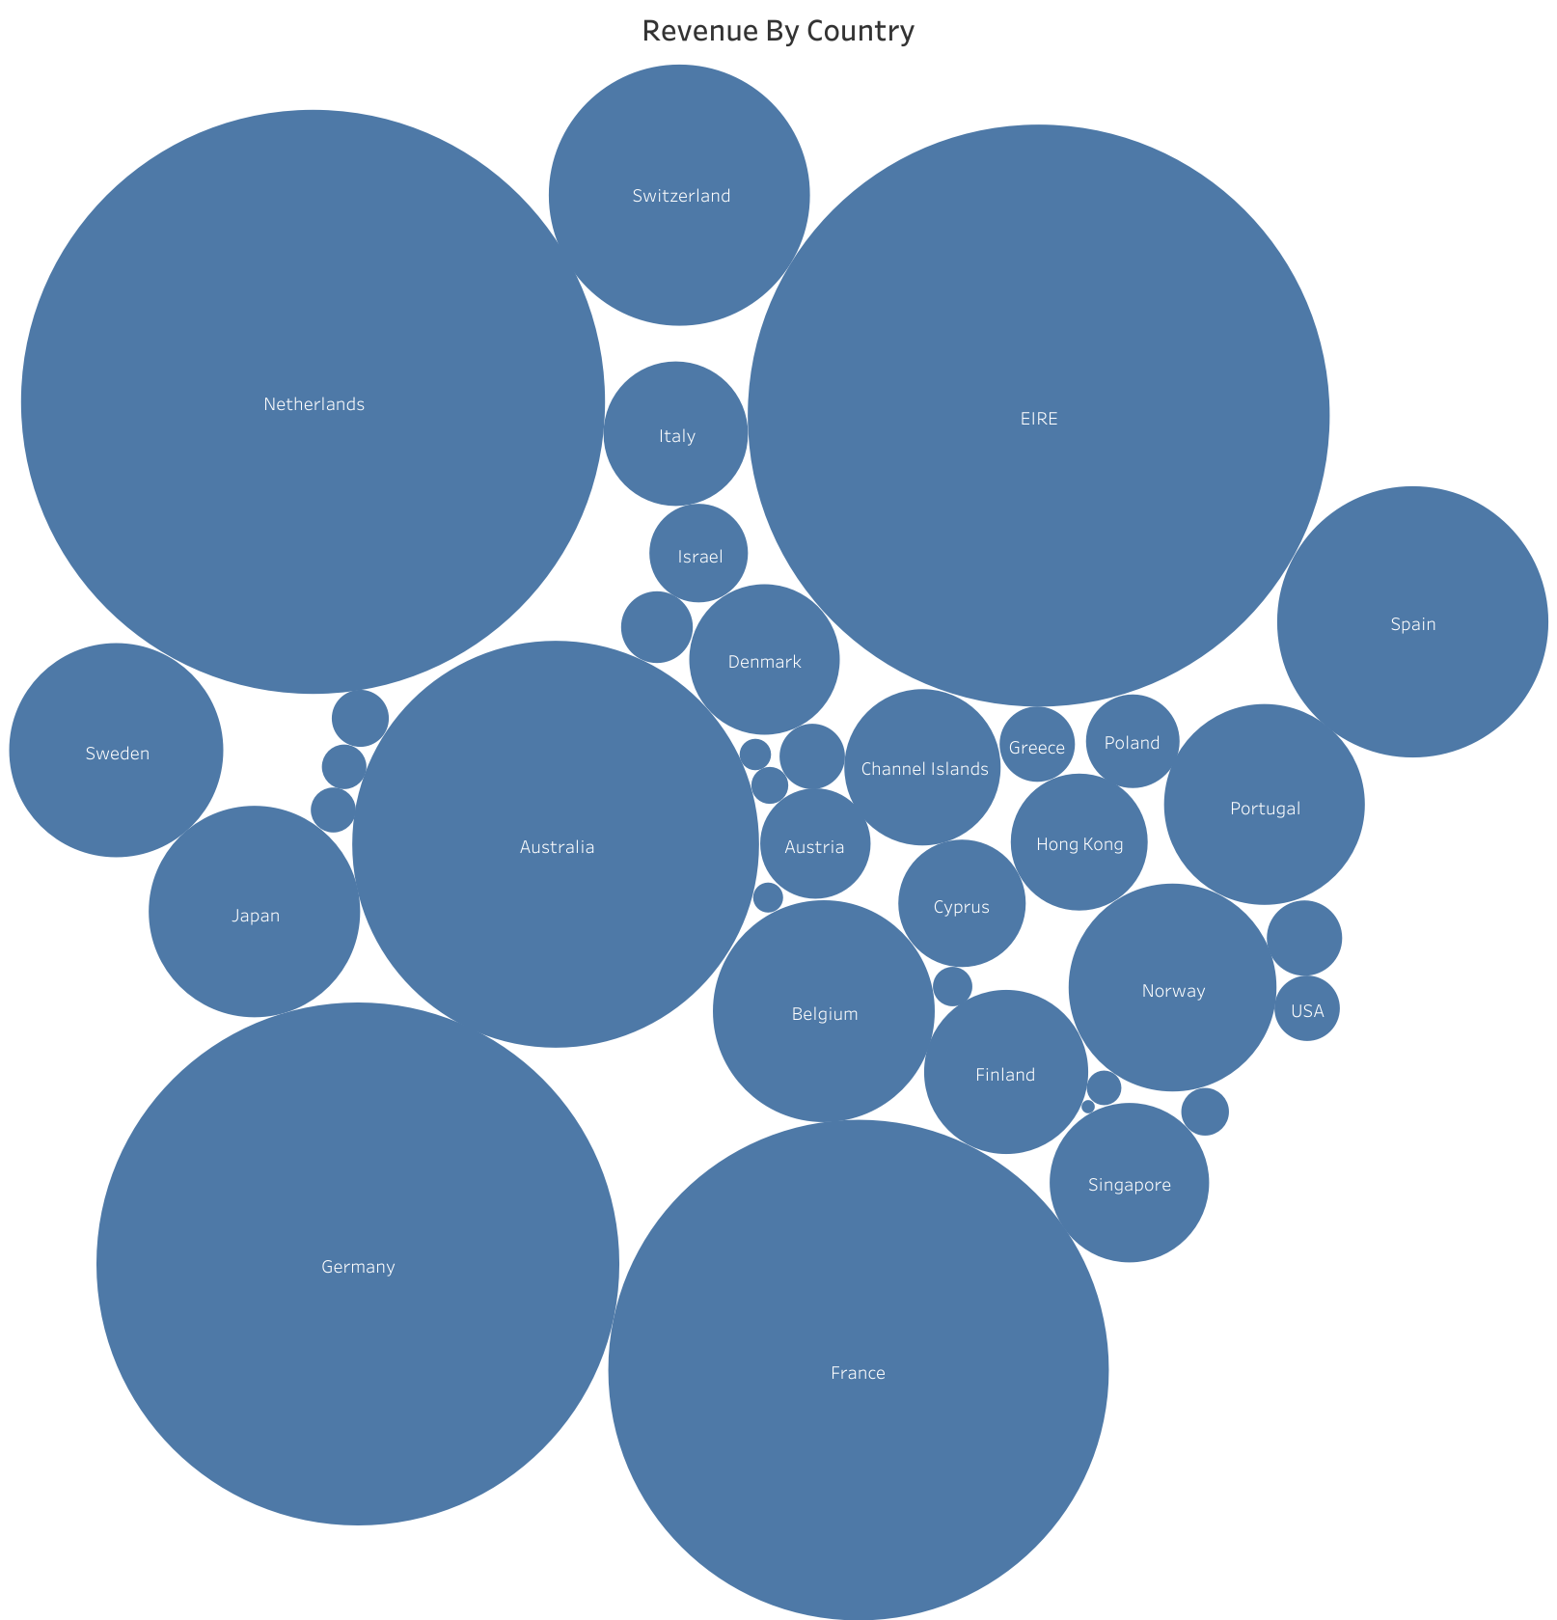

Slide 16
Recommendations
The company should come up with strategies that aim at stocking and advertising seasonal products to maximize sales when the demand for these goods goes up.
The company should do a deeper analysis of products that are usually in high demand during low-sales months to come up with strategies for marketing these products.
A deeper dive into the type of products and revenue generated from these products for each region would be key in guiding region-specific marketing strategies.
The company should consider incentivizing top revenue-generating customers to strengthen the relationship with these customers.
The EU market has more potential for growth and the company should aim at strategies that will increase its market positioning in the region.

Slide 17
Thank you
Angshuk Maity

